Slide 1
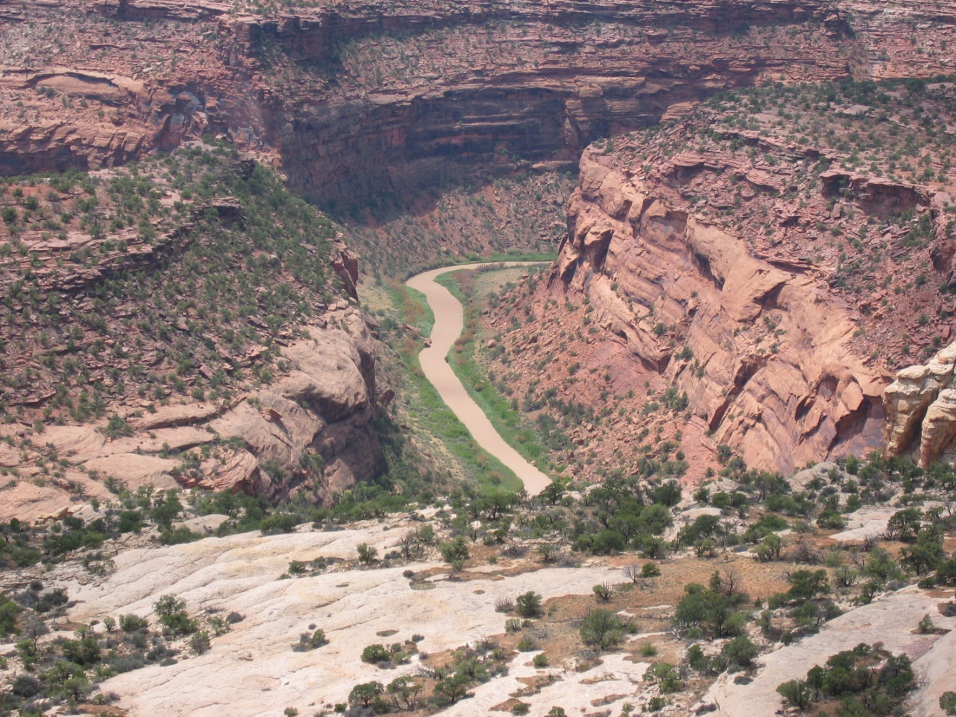
Tres Rios Field Office
Dolores River Restoration Project
2014

Slide 2
Dolores River Implementation Areas by Reach

Slide 3
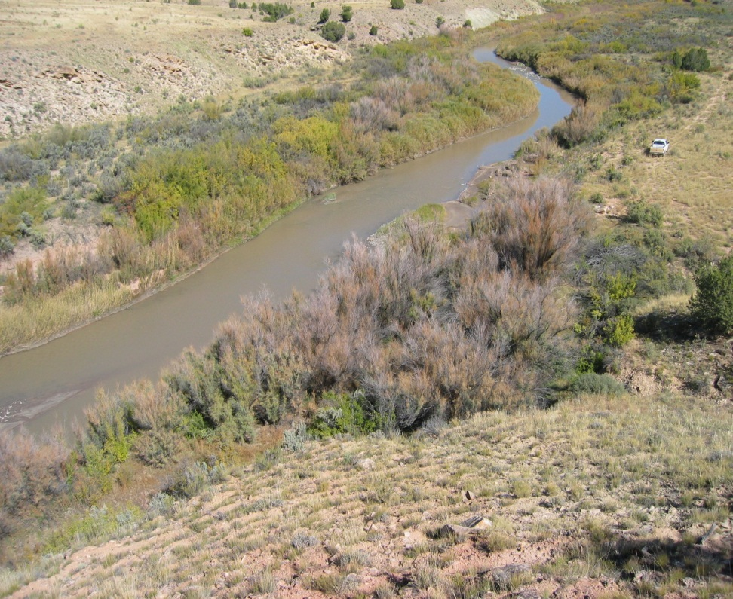
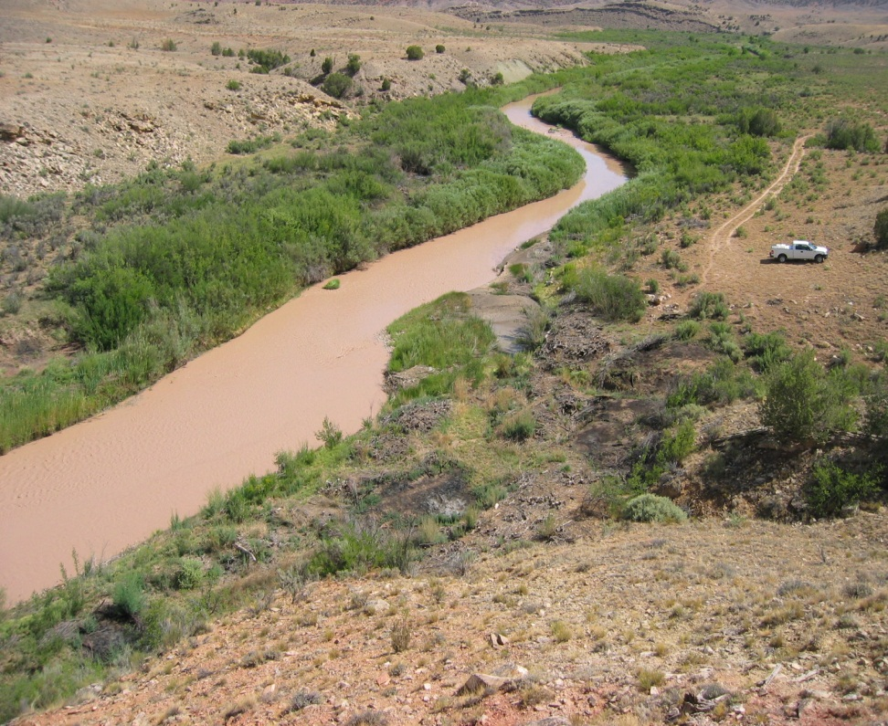
Dolores River
Initial Tamarisk Removal Completed 2009-2013
Reaches 1, 2, 4 & 5
Before
After

Slide 4
Disappointment Creek Implementation Areas by Reach

Slide 5
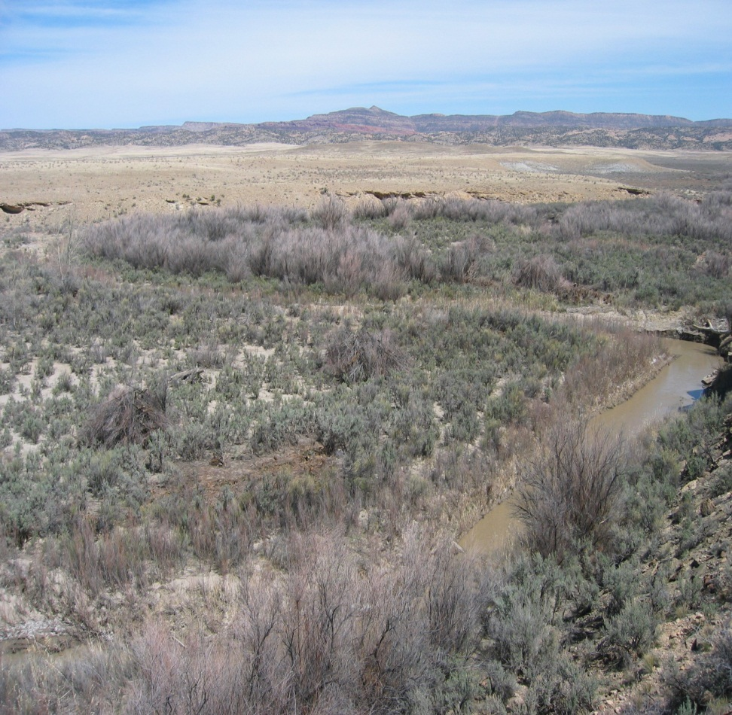
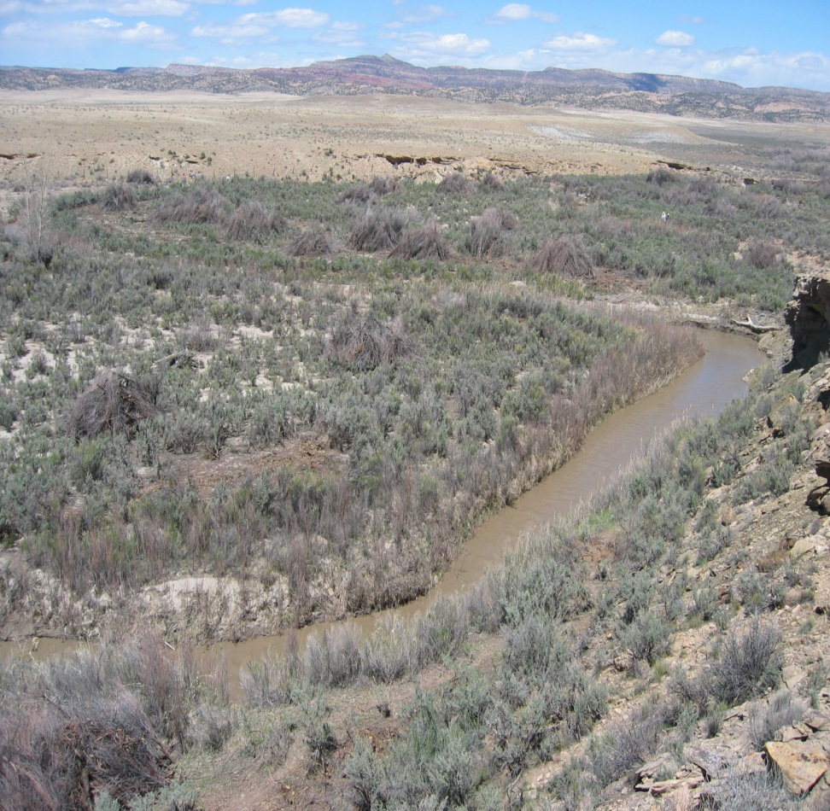
Disappointment Creek
Initial Tamarisk Removal Completed 2009-2013
Reaches 1,2 & 3
Before
After

Slide 6
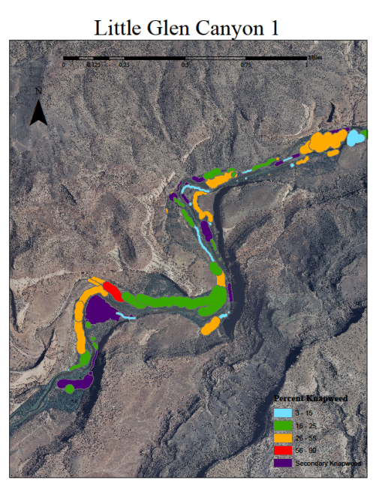
2012 Secondary Noxious Weed Inventory
SCC Interns Completed a noxious weed inventory of Dolores River on public lands from Dove Creek Pump Station downstream to Coyote Wash.
A total of 734 acres inventoried.
Inventory is being used to target and treat secondary noxious weeds.
Treatment of secondary noxious weeds began in 2012.

Slide 11
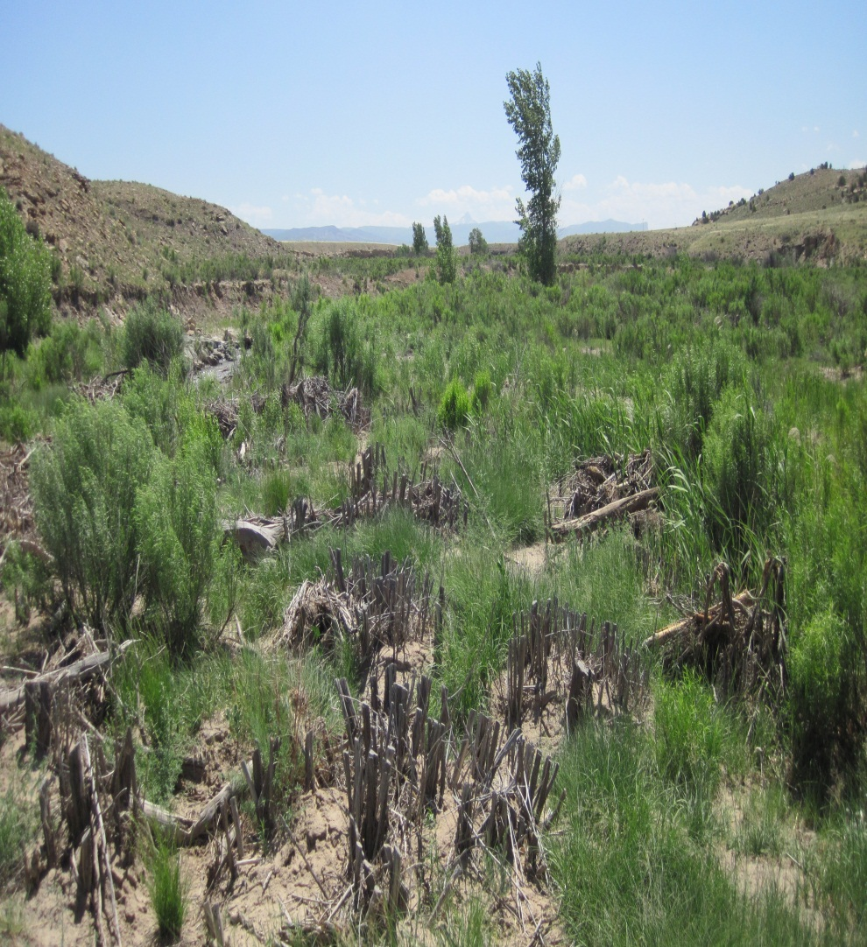
2014 Secondary Weed Treatment Totals
SCC Interns & TRFO Weed Crew
Dolores River
  85 acres
Disappointment Creek
  11 acres
Total Acres Treated
  96 acres

Slide 12
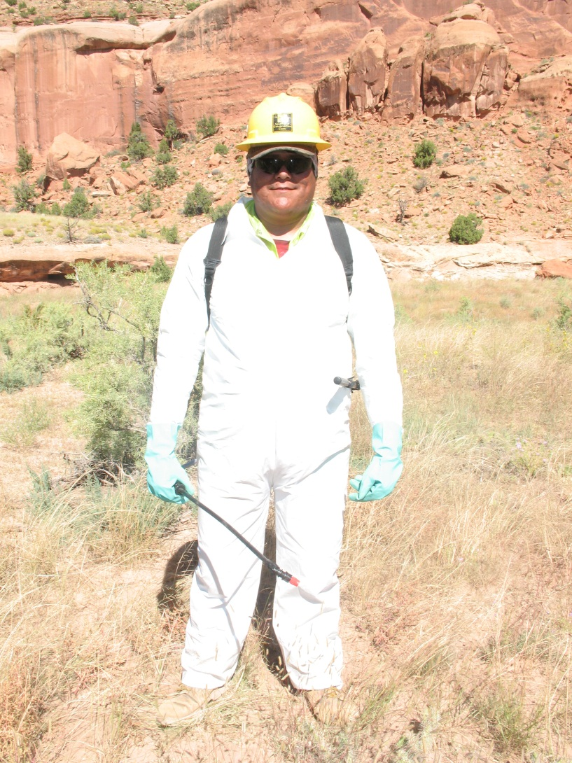
2014 Fall Treatment Remaining
SCC Interns will continue to treat Russian knapweed and tamarisk re-sprouts through the end of November 2014.

Slide 13
Future Program or Work 2015 and Beyond
Continue to Utilize SCC Interns for continued treatment of secondary noxious weeds and tamarisk re-sprouts.
Continue monitoring efforts to evaluate treatment effectiveness and change over time.
Where possible integrate other TRFO noxious weed treatment & inventory efforts within the Dolores River watershed.

Slide 15
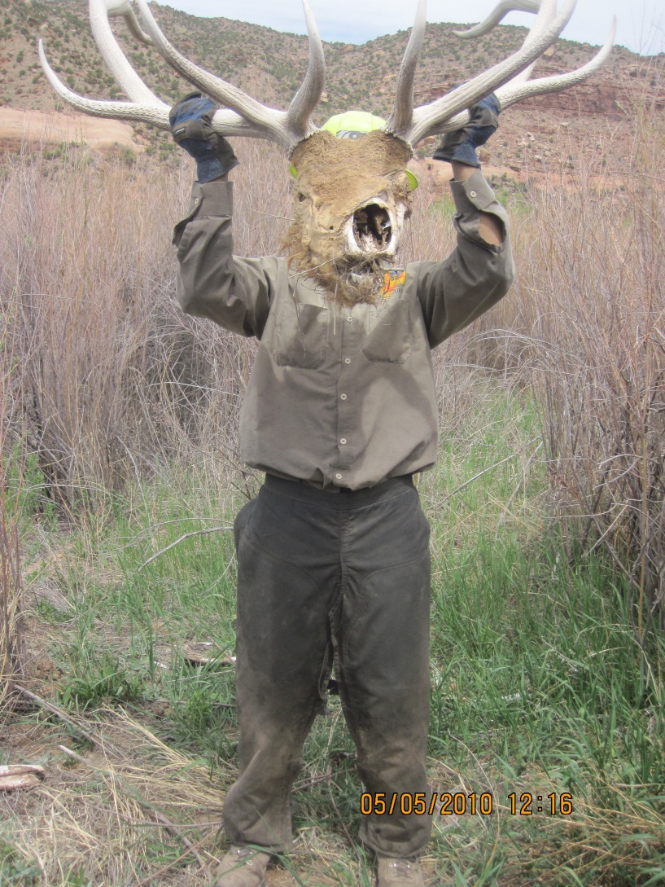
Questions?

